Slide 1

Social Network Analysis Day 1
Advanced Winter School in Computational Social Science 2025
Carl Nordlund Maël Lecoursonnais Kazuki Sakamoto

Slide 2

Day 1: Friday 5th Dec
Introduction to module
Relational thinking and research design
Communities and other cohesive subgroups
Role structures and blockmodeling
Lab details

Slide 3

Day 2: Monday 8th Dec
Comparing networks (QAP)
Network null models: rewiring, configuration models, backboning
Simulations
Relations and nodal attributes: introduction to network dynamics
Research design considerations

Slide 4

Social Network Research Design component
Available on the Winter CSS Github!
Three papers
Gerbrands P, Unger B, Getzner M, et al. (2022) The effect of anti-money laundering policies: an empirical network analysis. EPJ Data Sci. 11, 15. https://doi.org/10.1140/epjds/s13688-022-00328-8
Thiemann C, Theis F, Grady D, Brune R, Brockmann D (2010) The Structure of Borders in a Small World. PLoS ONE 5(11): e15422. https://doi.org/10.1371/journal.pone.0015422
Yang Y, Chawla N V, Uzzi B (2019) A network’s gender composition and communication pattern predict women’s leadership success. PNAS, 116(6), pp. 2033-2038. https://www.pnas.org/cgi/doi/10.1073/pnas.1721438116
Read through these papers before Monday 8th December!
Put special focus on their research design!
Research questions
Data and operationalization
Methods
Special focus
One paper/student

Slide 5
Paper assignments

Slide 6

Aim and Purpose
Introduction to network thinking
Get gears running
Seeing networks
Foundational tools/starters
Pave the way forward (RQs, more advanced methods)
Limitations
Only 2 days
First principles assumed
More structural (less attributional)
Much more in the SNA toolbox
Some repetition and recognition from CSS Summer school

Slide 7
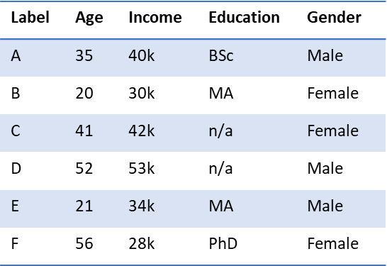
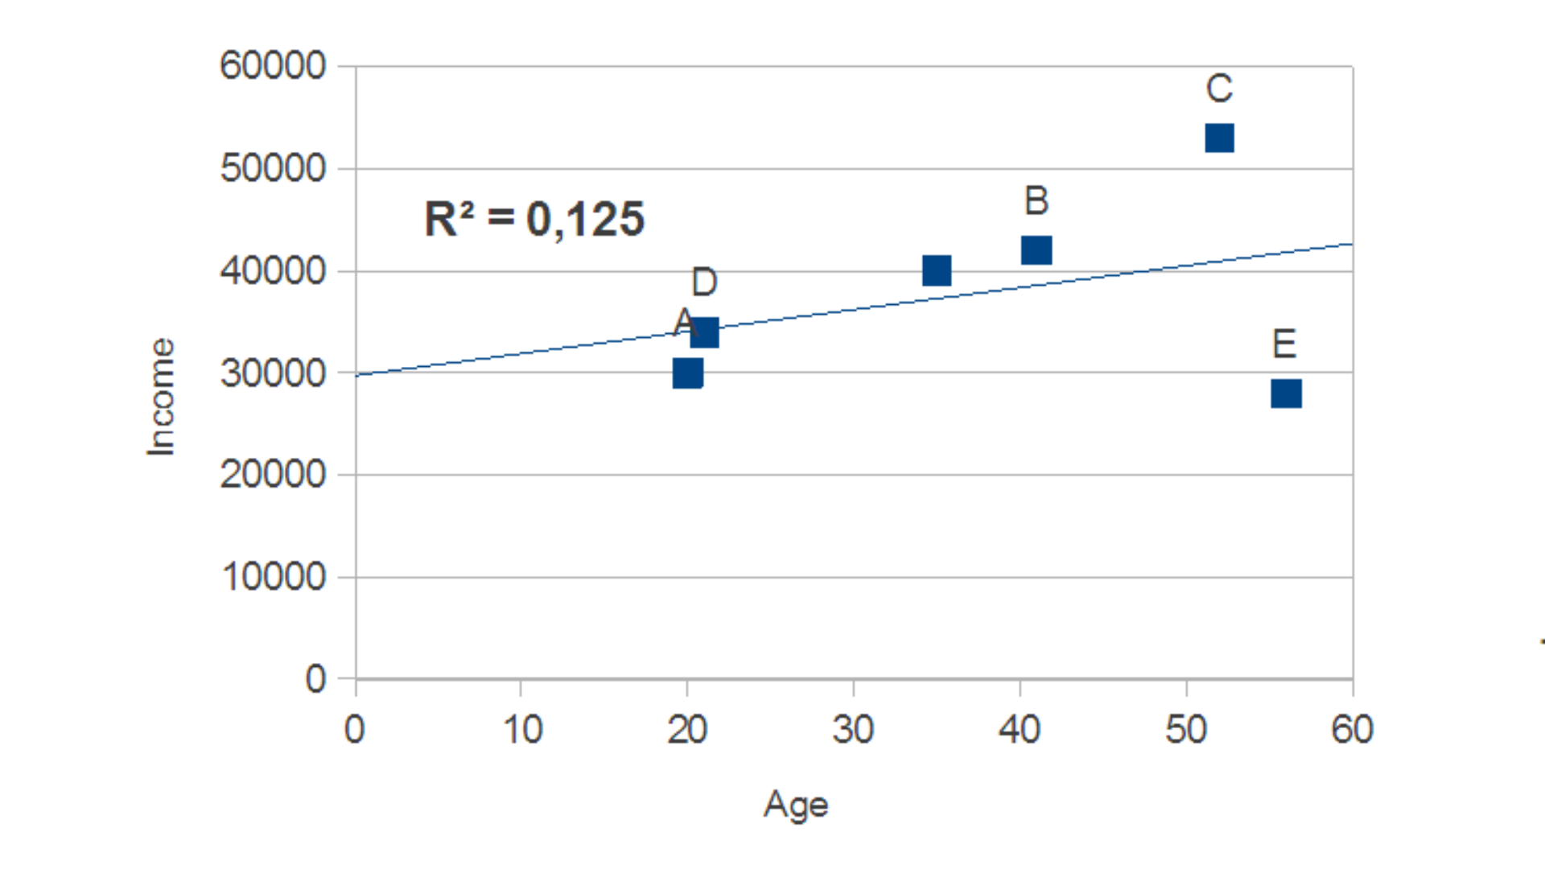
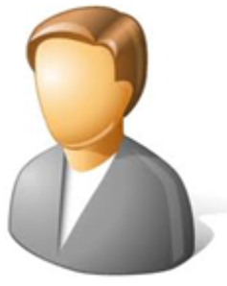
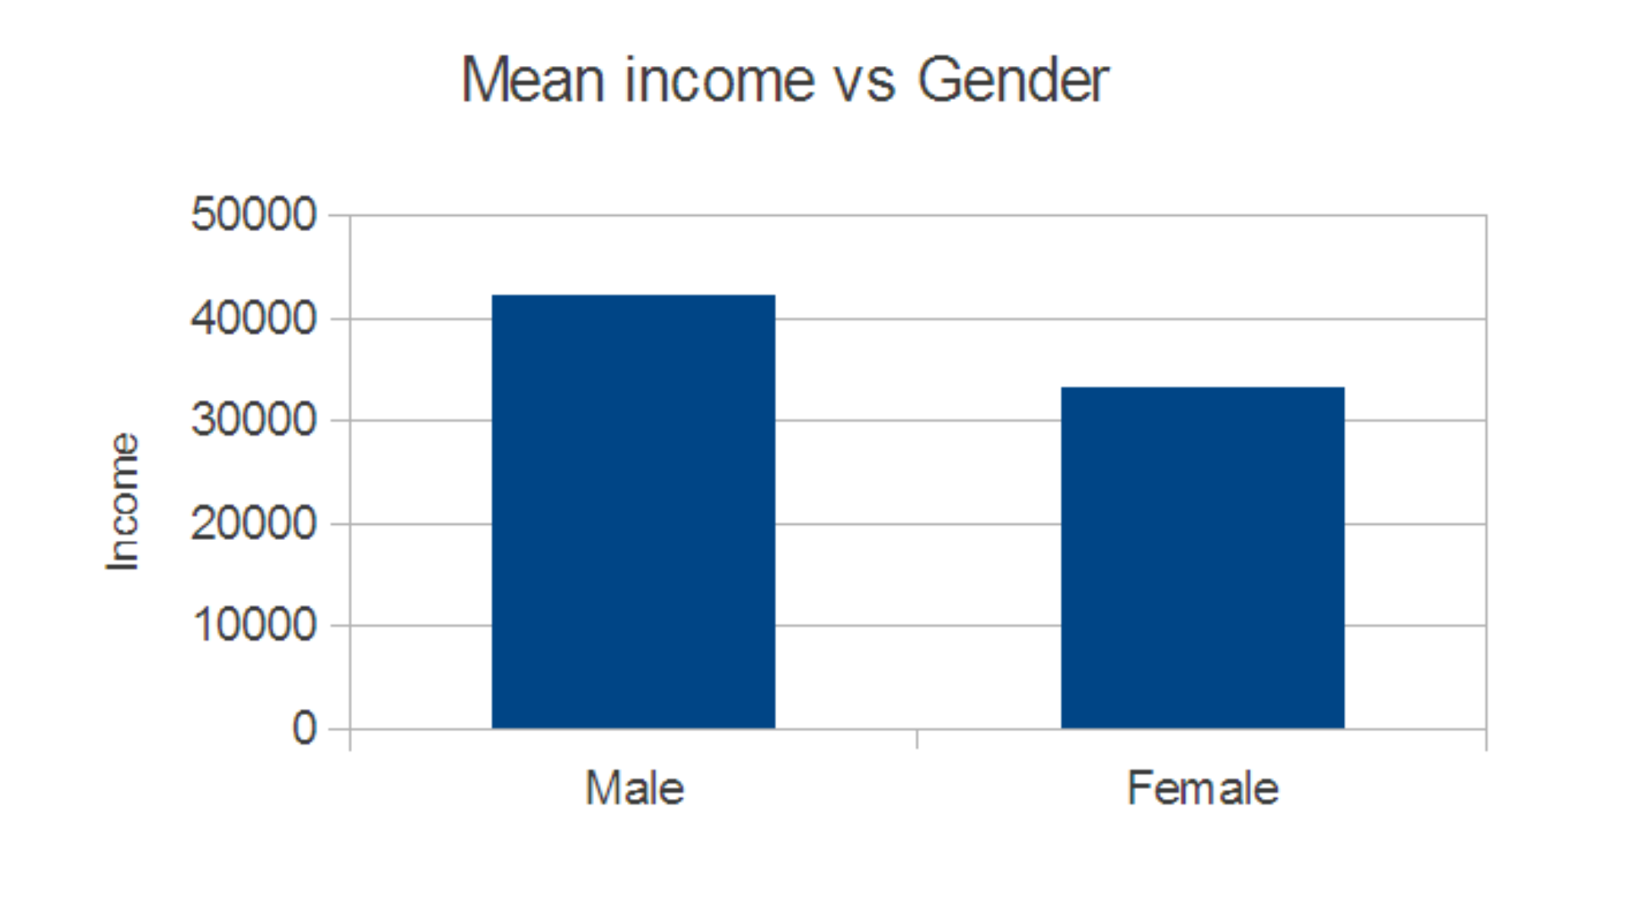
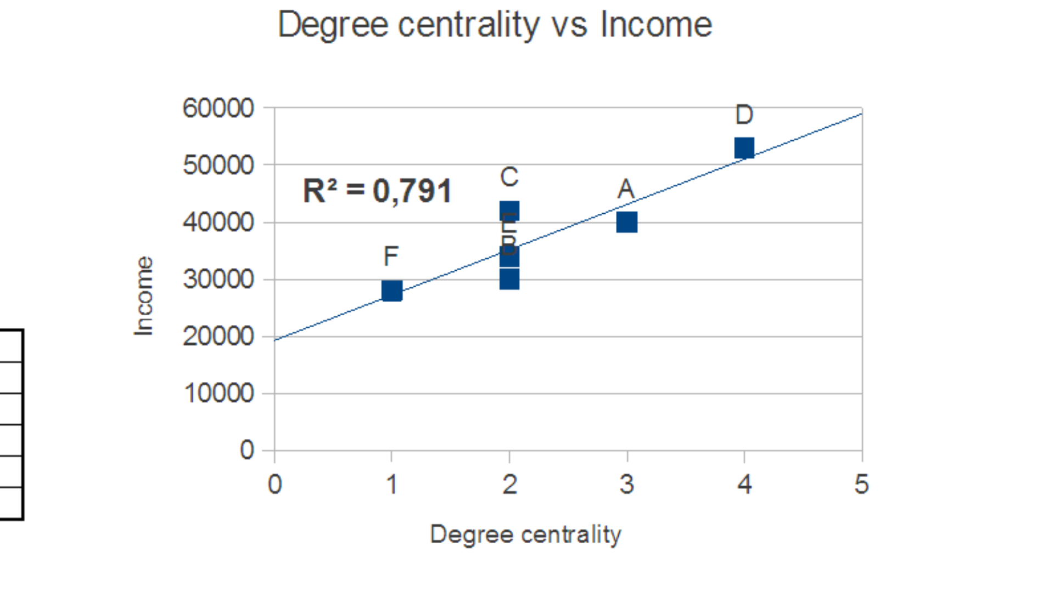
Relational vs attributional data
Entities: actors / nodes / vertices (here: social ones, e.g. individuals)
Actor attributes (“traditional” data table)
Relations: data between entities (e.g. friendship, kinship, shared affiliations)
E
Age: 21
Income: 34k
Education: MA
Gender: Male
A
Age: 35
Income: 40k
Education: BSc
Gender: Male
F
Age: 56
Income: 28k
Education: PhD
Gender: Female
Friendship (reciprocated) [matrix-format]
B
Age: 20
Income: 30k
Education: MA
Gender: Female
D
Age: 52
Income: 53k
Education: n/a
Gender: Male
 | A | B | C | D | E | F
A | - | 1 | 1 | 1 | 0 | 0
B | 1 | - | 0 | 1 | 0 | 0
C | 1 | 0 | - | 1 | 0 | 0
D | 1 | 1 | 1 | - | 1 | 0
E | 0 | 0 | 0 | 1 | - | 1
F | 0 | 0 | 0 | 0 | 1 | -
C
Age: 41
Income: 42k
Education: n/a
Gender: Female

Slide 8
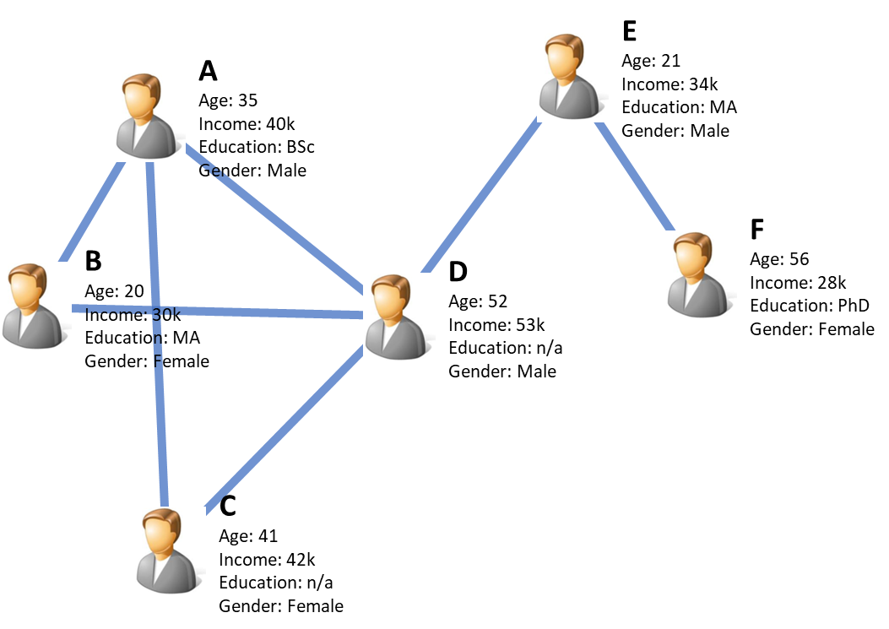
Relational data
Capturing the in-between
Inter-dependence of observations
Removing a ‘data point’ can have grand implications
Sampling typically problematic
System boundaries for full populations important
Supplementing ‘conventional’ (attributional) data
Ethical considerations!
Friendship (reciprocated) [matrix-format]
 | A | B | C | D | E | F
A | - | 1 | 1 | 1 | 0 | 0
B | 1 | - | 0 | 1 | 0 | 0
C | 1 | 0 | - | 1 | 0 | 0
D | 1 | 1 | 1 | - | 1 | 0
E | 0 | 0 | 0 | 1 | - | 1
F | 0 | 0 | 0 | 0 | 1 | -
The Robins reminders
Incorporating network data and metrics far more than a mere methodological extension
Explicit theoretical commitments about structure and dependence: that the in-between matters!
Going beyond Hobbesession with individual, assumedly independent entities to understand social world

Slide 9

Understanding high-school student performance
Classes of high-school students
Understanding drivers behind performance
Variables (attributes)
Grades, test scores
Gender
Ethnicity
Parents’ education, SES
Previous grades
Eye sight (!)
Relational data
Friendship (self-reported)
Social interaction (observed)
Antagonism
Kinship (siblings)
Note-borrowing
Residential neighbors
Affiliation (2-mode) data
Student clubs/associations
Sports/hobbies
Spoken languages

Slide 10

National economic development
Nations as units
Population
GDP/capita
Gini coefficients
Sectorial employment
Value-added (creation, trade-in)
Main exports/imports
Trade agreements
Organizational memberships
Labor demographics
R & D expenditure
Relational data
Bilateral trade flows (aggregated)
Bilateral trade flows (detailed)
Geographical contiguity
Trade envoys
Sanctions, boycotts and military conflicts
Cultural exchange
Airline traffic, other infrastructure
Affiliation (2-mode) data
Trade/treaty agreements
Organizational memberships

Slide 11
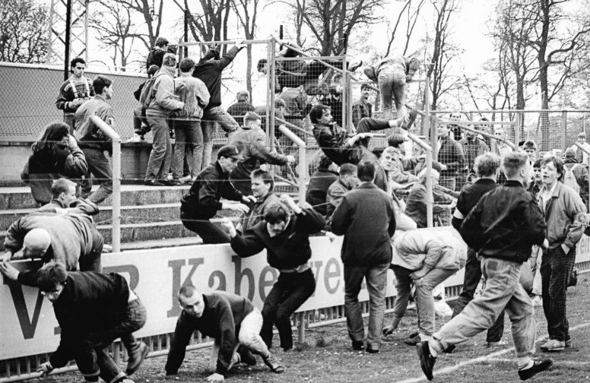
Becoming a (soccer) hooligan
Individuals as units
Gender
Age
Ethnicity
Interests
School grades
Substance abuse
Family situation
Employment
Criminal records
Relational data
Social exposure
Peer influence
Friendships (various domains)
Rivalry and antagonism
Affiliation (2-mode) data
Trade/treaty agreements
Organizational memberships

Slide 12

Employee productivity
CEO
Sales
Intl
Domestic
Engineering
Software
QA
Hardware
Individuals as units
Age
Education
Job title
Salary
Health care plan
Tasks completed
Evaluations
Skills
Relational data
Organizational structure (formal)
Organizational structure (actual!)
Information flows (individuals and units)
Inter-personal ties
Friendship
Antagonism
Reports-to
Advice-seeking

Slide 13

Popular Norrköping museums
Venues
Daily visitors
Type (art, history, contemporary, gallery)
Entry cost
Opening hours
Popularity
Time spent
Media mentions
Online reviews
Relational data
Road network (betweenness centrality etc.)
Mobility flows (“bilateral” pedestrians)
Collaborations with other venues
Affiliation (2-mode) data
Co-visits (individuals vs. venue)
Media mentions (as 2-mode)

Slide 14

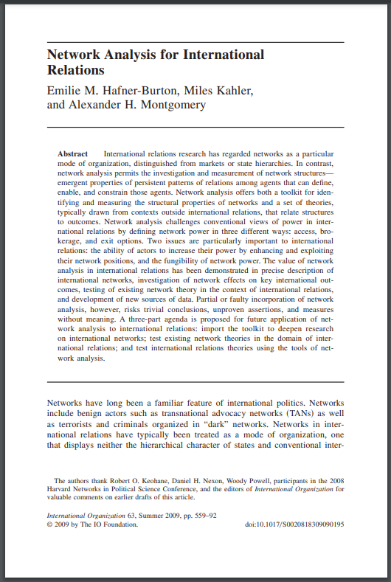

Relational turn → Novel questions and theory
Novel theoretical considerations
From endogenous to exogenous explanations
Interplay of attributional and relational variables
Going beyond ‘Hobbessession’ of assumed independent atomic units
Are relations relevant?
Contextual
Certain theoretical frameworks purely relational/attributional
E.g. post-war development studies:
Modernization school Harrod-Domar domestic capital formation, national policy, stages of economic development
Dependency/world-system tradition External constraints, power-relations, delinking, development of underdevelopment etc

Slide 15


Reasons for network analysis
To understand how individuals in certain social position have different individual outcome
To understand how individuals affect social structure
To facilitate this: (as always) intricate interplay between:
Research question
Data
Methods
Theory
Robins (2015), Doing Social Network Research: Network-based Research Design for Social Scientists

Slide 16

Social groups and communities
Social group: core notion in sociology and social sciences
Where we influence each other
Reflecting homophily
Development of group norms and standards
Groups typically defined relationally
Could of course also be based on attributes

Slide 17

Communities (aka cohesive subgroups)
The shared relational notion of cohesive subgroup
A subset of actors/nodes that are more connected to others within the set than what they are with the outside
As notion of social group is quite generic
Many possible definitions of cohesive subsets
A plurality of operationalizations that reflects a plurarity of conceptualizations (e.g. Freeman (1992) on the sociological concept of group)
Let’s explore some of these classical types of cohesive subgroups

Slide 18
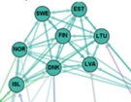
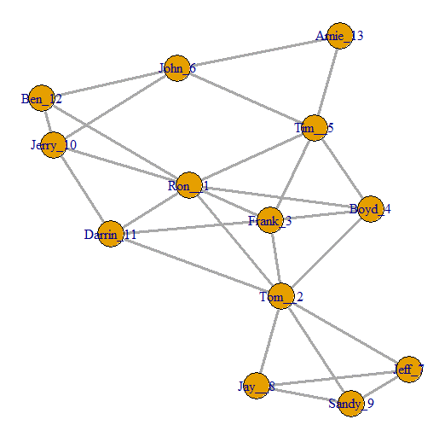
Meso-level statistics: Cliques
A maximal complete subgraph of 3 or more actors, where…
All actors are connected to each other
No other actors that are equally connected to all actors in the clique
A network typically consists of a lot of cliques of various sizes (particularly triads, i.e. n=3)
These cliques often overlap each other
A clique of size 4 contains several cliques of size 3, but the latter ones ignored (see above)

Slide 19
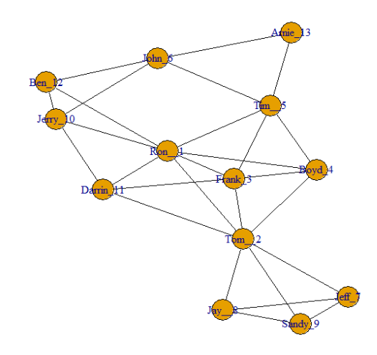
Meso-level statistics: Cliques: Little League TI
Igraph function: max_cliques()
8 cliques
4 cliques of size 4 (marked in red)
Tom__2, Ron__1, Frank_3, Boyd_4
Tom__2, Ron__1, Frank_3, Darrin_11
Frank_3, Ron__1, Tim__5, Boyd_4
Tom__2, Sandy_9, Jay__8, Jeff_7
4 cliques of size 3
Arnie_13, Tim__5, John_6
John_6, Jerry_10, Ben_12
Ron__1, Jerry_10, Darrin_11
Ron__1, Jerry_10, Ben_12
Note that there are more triads inside the cliques of size 4, but as they are within larger cliques, they are not maximum cliques

Slide 20
Meso-level statistics: n-cliques
A clique requires that each node is maximum one edge away from all others
The n-clique relaxes this
An n-clique is a maximum subgraph where distances between all pairs of nodes is no more than n
Maximum: there can be no other additional node
When n=1: standard clique
Varieties:
n-clan Additional condition: max diameter no longer than n
n-club
Example of 2-cliques (there are more)

Slide 21
Meso-level statistics: k-plex
Maximal subgraph with n nodes in which each node is adjacent to no fewer than (n-k) nodes in subgraph
Introduced in Seidman & Foster (1978)
Ignores self-ties
A clique is a 1-plex
Testing hypothetical 3-plex (figure to the right)
n=8
Max 3 missing ties (including self-tie)
Must have ties to no fewer than 5 in subgroup
‘can’ only has 4 within-group ties: this is not a 3-plex!

Slide 22
Meso-level statistics: Communities
A plethora of SNA-style cohesive subgroup definitions
From network science: a more practical and generic take on cohesive subgroups
‘Community’ instead of ‘cohesive subgroup’
Less contextual, yet widely used among social scientists as well
References:
Newman & Girwan (2004)
Vincent et al (2008)
Clauset, Newman & Moore (2004)
Coscia et al (2011)
Peel et al (2017)
Most using notion of modularity to measure separation of groups, but different heuristics to get there

Slide 23
Meso-level statistics: Newman-Girwan edge betweenness
Recall betweenness centrality: captures how often node is on shortest path between all pairs of nodes
Edge betweenness: how often an edge (relation) is on shortest path between all pairs of nodes
Reasonable that edges with a high edge betweenness are those between communities!
Newman-Girwan heuristic:
Calculate edge betweenness for all edges
Remove edges with highest edge betweenness
Evaluate how well-separated potential communities are
Evaluation based on notion of modularity

Slide 24
Meso-level statistics: Modularity
Measures how well-separated communities are
Given a partition of nodes into distinct non-overlapping sets
Modularity reflects the fraction of edges within such sets, minus the expected fraction of edges if they were distributed randomly
In-build null model consideration Clauset, Newman & Moore (2004)

Slide 25
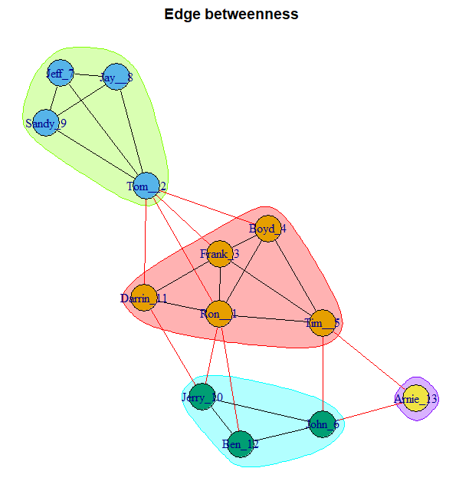
Meso-level statistics: Newman-Girwan edge betweenness
Identifying communities using the Newman-Girwan edge betweenness heuristic
4 communities identified
Modularity: 0.285 (not that high)

Slide 26
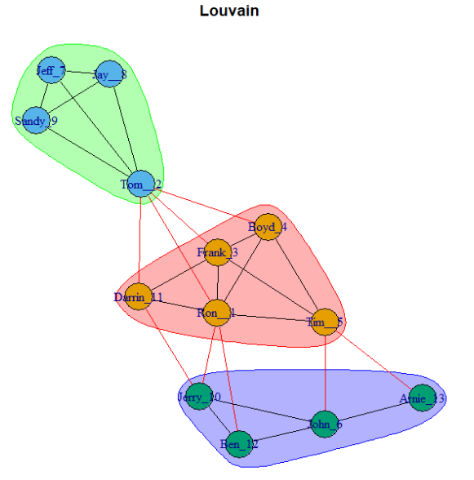
Meso-level statistics: Louvain heuristic
Search algorithm to maximize modularity
Starts with each node as community of its own (singleton)
Vertices merged when this increases modularity (searching for optimal merge)
Stops when either single community or no longer possible to increase modularity
From Blondel, Guillaume, Lambiotte & Lefebvre (2008)
3 communities identified
Modularity: 0.307

Slide 27
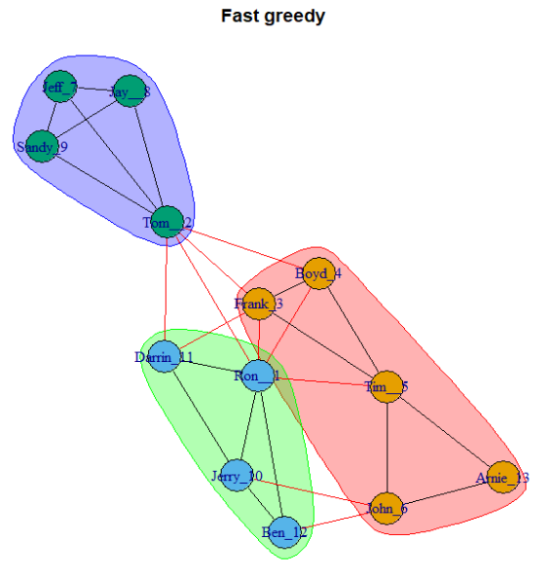
Meso-level statistics: Fast and greedy heuristic
Fast search algorithm
Particularly for large networks
From Clauset, Newman & Moore (2004)
3 communities identified
Modularity: 0.294

Slide 28
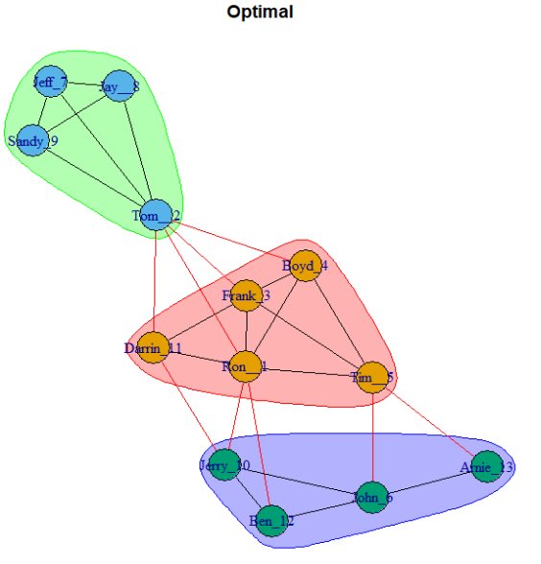
Meso-level statistics: Optimal modularity
Naïve search algorithm
Tests all possible partitions
Only viable for small networks
Guaranteed to find partition with highest modularity
3 communities identified
Modularity: 0.307
Identical to what was found with Louvain!

Slide 29
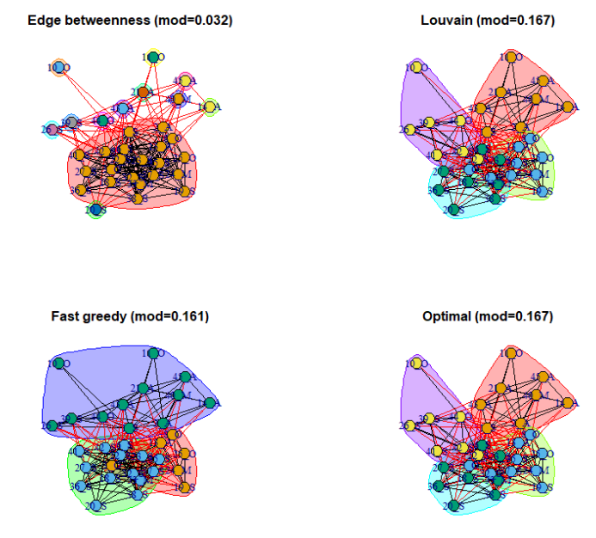
Meso-level statistics: Communities: interpretational aspects
So which one to pick?
Different approaches potentially yields different partitions
Not always finding most optimal (w.r.t. modularity)
And is modularity all we need to evaluate community structures in all contexts?
Peel et al (2017):
Seldom a ground truth in community detection
No Free Lunch Theorem: “There can be no algorithm that is optimal for all possible community detection tasks”
Coscia et al (2011): Classification of methods for community detection

Slide 30
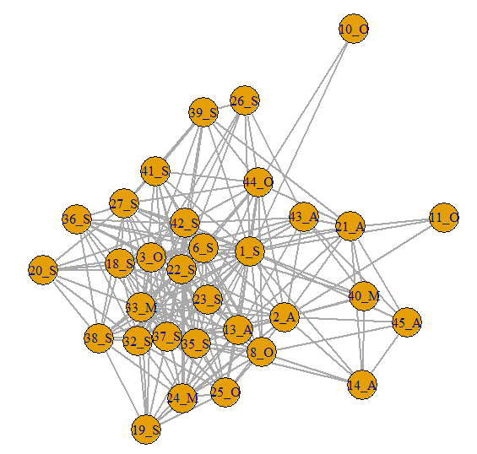
Structures vs. attributes
Do observed communities reflect nodal attributes?
Introducing the EIES example data
32 scholars attending an early SNA conference
Reported acquaintances (directional, Likert 1-4)
Disciplinary backgrounds: Sociology (17), Anthropology (6), Mathematics (3), Other (6)
Dichotomized (>=2) and min-symmetrized
Pre-conference (also data for post-conference)
You will explore communities in this network in the lab today!

Slide 31
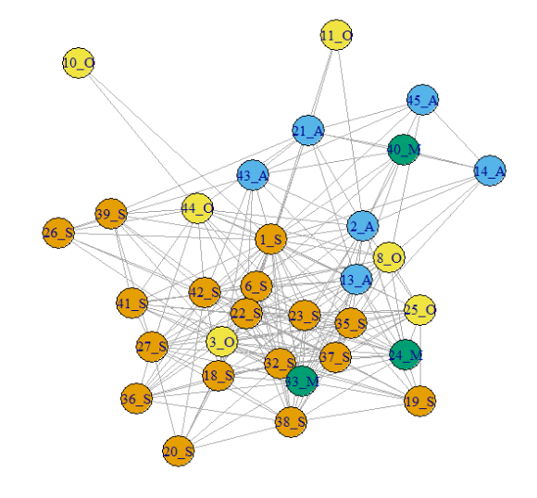
Structures vs. attributes
Finding some communities in this data
Do observed communities reflect nodal attributes?
Ocular inspection:
Sociologists indeed seem to stick together
Anthropologists as well
Maths and Others more dispersed
But to properly test for assortative mixing, we instead start off with the attributes
Using assortativity coefficient of Newman (2003) most viable
High coefficient: connected nodes tend to share same (nominal) attribute

Slide 32
Structures vs. attributes
Igraph: assortativity_nominal()
Assortativity coefficient = 0.106
So slight assortative mixing, but not much!
In visualization, it indeed looks like a lot of sociologists hanging together
But bear in mind: many sociologists
Quite likely that they would mix by chance as well

Slide 33
Social roles
Early 1970s, sociologists thought about the notion of social role
Harrison White: can this be defined in a purely relational form?
Society IS social structure
Multiplex network of inter-personal relations
Roles and identities in society are “reciprocally defined”
Only emerging in the interactions

Slide 34

Conceptual notions of role and position At a hospital
Four types of actors:
Doctors
Nurses
Admins
Patients
Different roles, as reflected in their interaction patterns:
Doctors relate to each other, and to patients
Nurses relate to doctors, patients and admins
Admins relate to patients
Patients relate to all, but not other patients

Slide 35

Conceptual notions of role and position Schools
Three types of actors:
Kids
Teachers
Parents
Different roles, as reflected in their interaction patterns:
Parents within a family relate to each other, and to some other parents
Parents relate to their own kids, not to other kids
Teachers relate to all kids, some parents, some teachers
Kids relate to other kids

Slide 36
Conceptual notions of role and position Patterns of relations
Seemingly overlap between actor attributes and relational patterns
Relations not necessarily reflecting cohesive subgroups
Patients visiting a hospital have no functional relations with other patients
Parents might interact with other parents, but not necessarily
Being a teacher, parent, doctor etc thus seems to associate with certain relational patterns
…that might or might not be cohesive subgroups
Role analysis and blockmodeling: tools for identifying specific roles on the basis of relational patterns

Slide 37
Conceptual notions of role and position Patterns of relations
Role-analysis:
Identifying sets of nodes that share similar relational patterns
Notion of being (structurally) equivalent
i.e. on the basis of relational patterns alone
Mapping the overarching patterns of relations between such identified sets of equivalent nodes
Blockmodeling:
The quintessential technique for role analysis

Slide 38
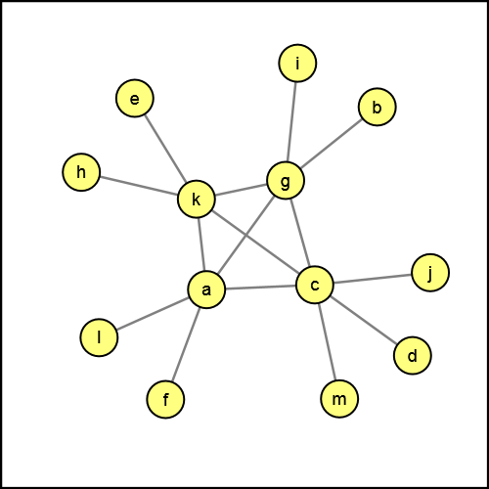
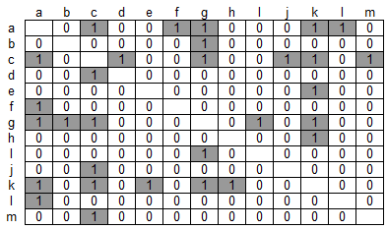
Meso-level statistics: Role-analysis and blockmodeling
Example: feudal interaction structure (Galtung 1971)
Ocular inspection:
A set of 4 “central” and connected actors in the middle
Rest of actors “hanging on”, only connected to these 4 central ones
Let us hypothesize that these correspond to two different “positions” (subsets of actors):
P1 = {a, c, g, k}
P2 = {b, d, e, f, h, I, j, l, m}

Slide 39
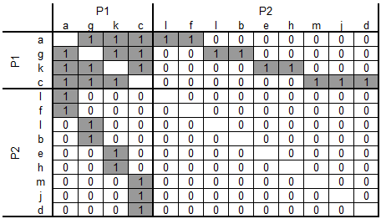
Meso-level statistics: Role-analysis and blockmodeling
Let us hypothesize that these correspond to two different “positions” (subsets of actors):
P1 = {a, c, g, k}
P2 = {b, d, e, f, h, I, j, l, m}
We sort the sociomatrix according to these two positions
Highlighting the positions, we arrive at a blockmodel
We note that a total of four blocks (2²) emerge:
P1 – P1 This is completely filled with ties (except diagonal)
P2 – P2 There are no ties whatsoever in this block
P1 – P2 This block has one tie on each of its row and columns
P2 – P1 Same as for P1 – P2

Slide 40
Meso-level statistics: Role-analysis and blockmodeling
The four blocks that emerge in this hypothetical blockmodel represent three ideal blocks in blockmodeling:
The complete block (com)
Structural equivalence blockmodeling
The null block (nul)
Regular equivalence blockmodeling
The regular block (reg)

Slide 41
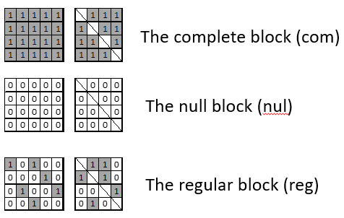
Meso-level statistics: Role-analysis and blockmodeling
As each of these blocks perfectly match an ideal block type, we can ‘collapse’ the blockmodel into a so-called blockimage – or an image graph
Nodes in the image graph now represent positions (i.e. subsets of equivalent actors)
The blockimage and image graph thus captures the underlying anatomy of the network
In this case, this corresponds to a core-periphery network
Roles:
Role of P1 is to be connected to others in P1, and having sporadic ties to and from P2
Role of P2 is to have no ties to others in P2, and singular ties to P1
Image graph
P1
P2

Slide 42
Meso-level statistics: Role-analysis and blockmodeling
Why blockmodeling and role-analysis?
A blockmodel reduces a complex network into its fundamental structure (functional anatomy)
In the Galtung network, we (obviously) find an ideal core-periphery structure
For a network many times the size, the same block image would appear
Allows for comparing complex networks that might differ in size, context, distributions

Slide 43
Meso-level statistics: Role-analysis and blockmodeling
Galtung example turned out to be a core-periphery structure
There are a multitude of other possibilities
Hierarchies
Transitive structures
Cohesive subgroups
Something very specific
An ideal community structure is a special case (one possible outcome) of blockmodeling
So: NOT EXPLICITLY looking for community structure, OR core-periphery structure
Rather: look for regularities in relational patterns
…which COULD be a community structure, a core-periphery structure, or something different
P1
P2
P3

Slide 44
Meso-level statistics: Types of equivalences
What is meant by equivalence in a network?
Different notions and usages exist
Structural equivalence
Two actors are structurally equivalent if they have identical sets of ties to the other actors
Ideal blocks: complete and null blocks
Regular equivalence
Two actors are regular equivalent if they have ties to actors that in turn are also regular equivalent (!)
Ideal blocks: null and regular blocks

Slide 45
Meso-level statistics: Types of equivalences
In the Galtung example, we managed to perfectly fit the network to ideal blocks – and on first attempt!
Real-world networks are more messy
Even our small example networks can be messy!
The ambition with blockmodeling: find the best possible fit
Two broad approaches for partitioning a network into equivalent positions
Direct methods
Indirect methods
(And also hypothesis testing)

Slide 46
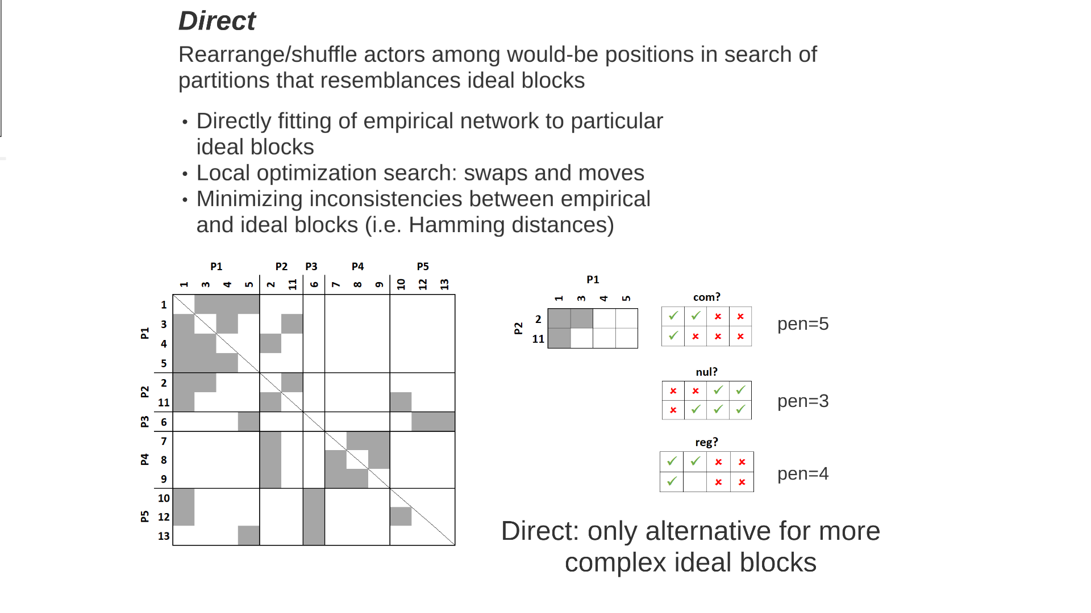
Meso-level statistics: Direct blockmodeling
Starts with a random starting partition for a specified number of positions
Local optimization search algorithm to move/swap actors between positions
Using goodness-of-fit (criteria) function to evaluate resulting blockmodels
Actual block image can be pre-specified (e.g. if explicitly searching for a core-periphery structure)
Can also be flexible: then testing all available ideal blocks
Typical goodness-of-fit measures
Hamming distances (number of inconsistencies)
(Weighted) correlation coefficients (also for valued networks)
Advantage:
Deemed better
Allows for capturing complicated ideal blocks (generalized blockmodeling)
Disadvantage:
Computationally heavy
Potentially finding local minima

Slide 47
Meso-level statistics: Indirect blockmodeling
Starts by calculating/determining a suitable indirect measure of equivalence
Most often structural equivalence
This results in a new (dis)similarity matrices indicating how structurally equivalent each pair of nodes is
Apply hierarchical clustering
Choose suitable number of positions
Create and interpret blockmodel
Advantage:
Works for large networks
Analytical, not computational
Disadvantage:
Restricted to certain notions of equivalence
Generalized blockmodeling: nope!
Lots of choices in the analysis

Slide 48
Meso-level statistics: Indirect structural equivalence
Structural equivalence
That two actors have the same relational patterns to the other actors
Let’s pick two actors – Tom_2 and Frank_3 – and look at their respective rows and columns:
Structural equivalence dissimilarity for Tom_2 and Frank_3 is 8
Repeat for all pairs to create dissimilarity matrix
Ignore self-ties
Check for reciprocity (once)

Slide 49
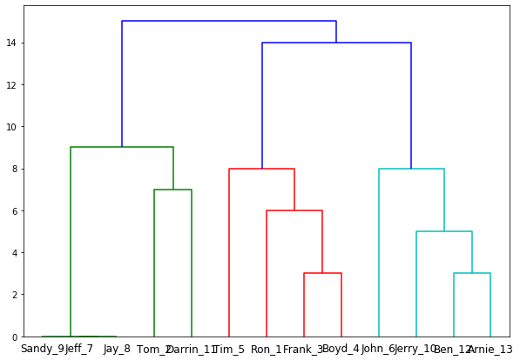
Meso-level statistics: Indirect structural equivalence
Start off with actual network
Calculate indirect measure of structural equivalence
Here, using Hamming distance dissimilarity (number of inconsistencies)
Apply clustering algorithm to identify structurally equivalent actors
Here, using (unweighted) average-link clustering

Slide 50
Meso-level statistics: Indirect structural equivalence
Examine dendrogram of hierarchical clustering (complete-link here)
Identify suitable partition
P1: Tom_2, Jeff_7, Jay_8, Sandy_9, Darrin_11
P2: Ron_1, Frank_3, Boyd_4, Tim_5
P3: John_6, Jerry_10, Ben_12, Arnie_13,

Slide 51
Meso-level statistics: Indirect structural equivalence
Not very “crisp” densities
Community structure (com on diagonal)
Inconsistencies: 27 (quite high)
Which explains why we have uncertain densities
Back to original matrix
Sort according to identified partitions
For binary blockmodels, calculating block densities can be useful
Ideally, block densities should be close to 0 (null) or 1 (complete)

Slide 52
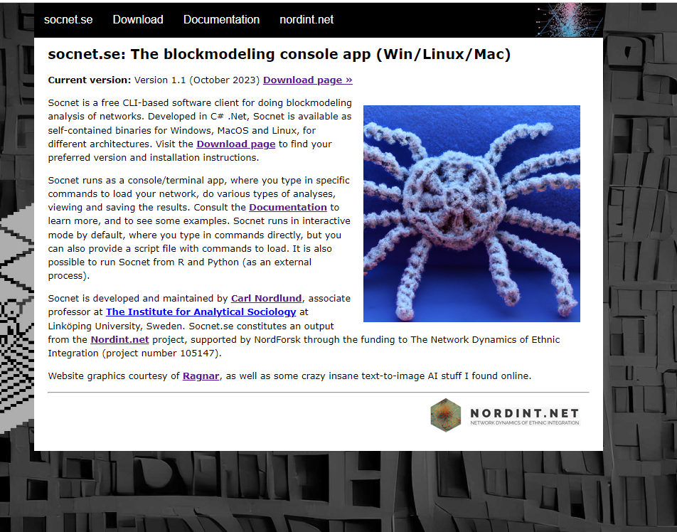
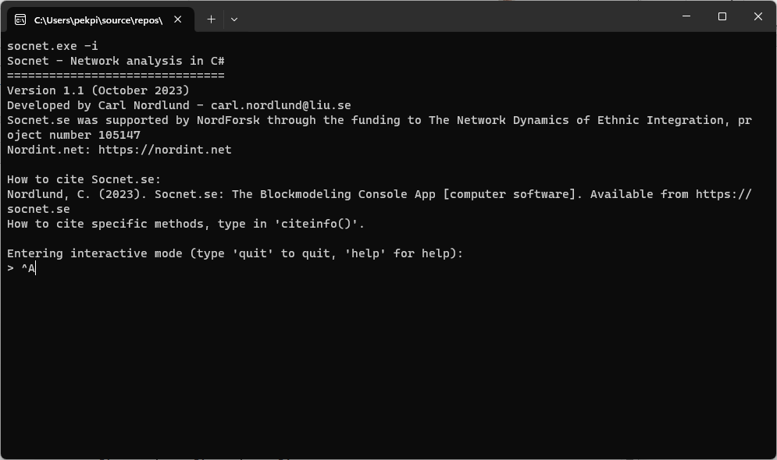
Socnet.se Client for direct blockmodeling
A fast (compiled) CLI-based client for direct blockmodeling
Version 1.4
Goodness-of-fit functions:
Hamming distances
Weighted correlations
Equivalences:
Structural
Regular
Generalized
Free-search or specified blockimage

Slide 53
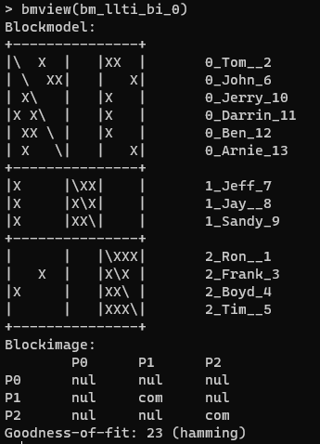
Socnet.se Client for direct blockmodeling
Socnet code to do direct blockmodeling of Little League TI data:
# Set working directory to where your network files are
setwd(C:\Users\pekpi\Dropbox\work\Winter CSS school\data)
# Load the matrix file (and rename it to llti)
loadmatrix(file=little_league_ti.txt, name=llti)
# Specify a non-specified 3-positional blockimage for structural equivalence
bi = blockimage(size=3, pattern=com;nul)
# Initialize the search engine
bminit(network=llti, blockimage=bi, searchtype=exhaustive, method=hamming)
# Start search (can take a while)
bmstart()
# Explore solutions
structures
# To view a Blockmodel (you should have 12), use:
bmview(bm_llti_bi_0)
Notably, direct blockmodeling finds a better partition (lower goodness-of-fit)
Actually finds two equally optimal solutions (and several isomorphic solutions that are excluded)

Slide 54
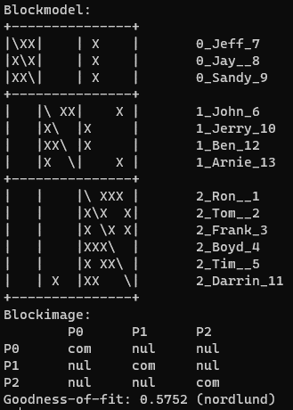
Socnet.se Client for direct blockmodeling
Instead of Hamming, we can use (weighted) correlations as GoF
Then we can’t use ‘exhaustive’, but instead the ‘ljubljana’ local opt algorithm
# Set working directory to where your network files are
setwd(C:\Users\pekpi\Dropbox\work\Winter CSS school\data)
# Load the matrix file (and rename it to llti)
loadmatrix(file=little_league_ti.txt, name=llti)
# Specify a non-specified 3-positional blockimage for structural equivalence
bi = blockimage(size=3, pattern=com;nul)
# Initialize the search engine
bminit(network=llti, blockimage=bi, searchtype=ljubljana, method=nordlund)
# Start search (can take a while with the ‘Nordlund’ option)
bmstart()
# Explore solutions
structures
# To view the Blockmodel (you should only have one now), use:
bmview(bm_llti_bi_94_0)
When using correlation coefficient, more likely to find singular optimal solution
Arguably easier to compare and interpret the fit than an absolute number of deviations

Slide 55
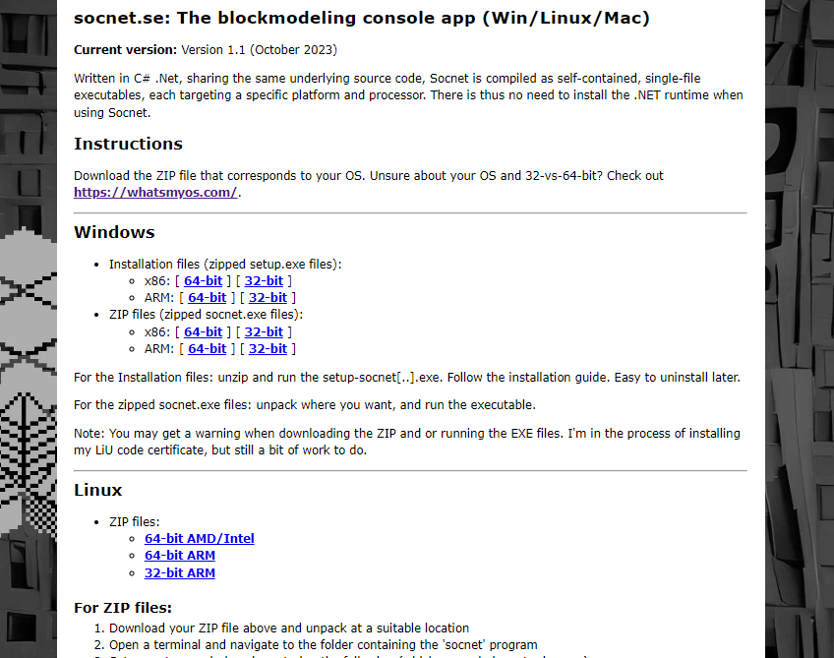
Socnet.se
Console/terminal application written in C#/.Net
Download at https://socnet.se/?page=download
Code-signed executable/binaries for Win, Linux, MacOS (setup.exe for Windows)
Although codesigned, could give warning when DL:ing on Chrome (though not Edge)
Full documentation at https://socnet.se/?page=docs

Slide 56

Afternoon lab

Slide 57
Lab (13-16ish)
Working with a bunch of classical datasets
Baker citation, EIES (t1, t2), Galtung, Hlebec notesharing, Knoke, Little league, Zachary karate club
Binary and valued, directional and symmetric
Single-layer
S50 data (Snijders’ Teenage Friends and Lifestyle Study data) https://www.stats.ox.ac.uk/~snijders/siena/s50_data.htm
R scripts
Lab_day_1.Rmd – exploring (also random graphs)
Cohesive_subgroups, assortativity (EIES), rewiring

Slide 58
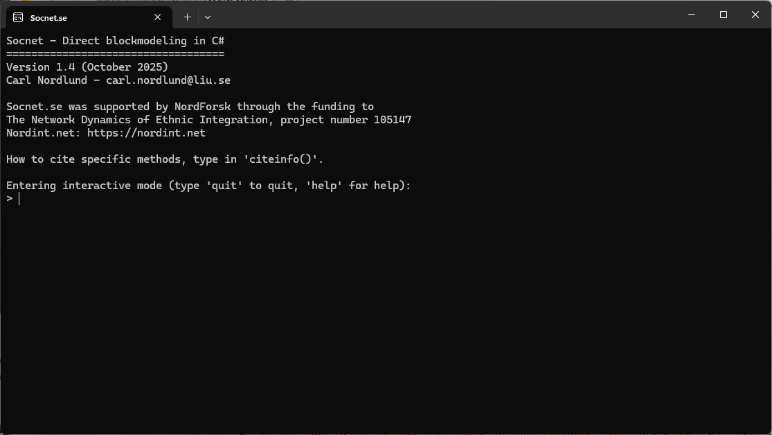
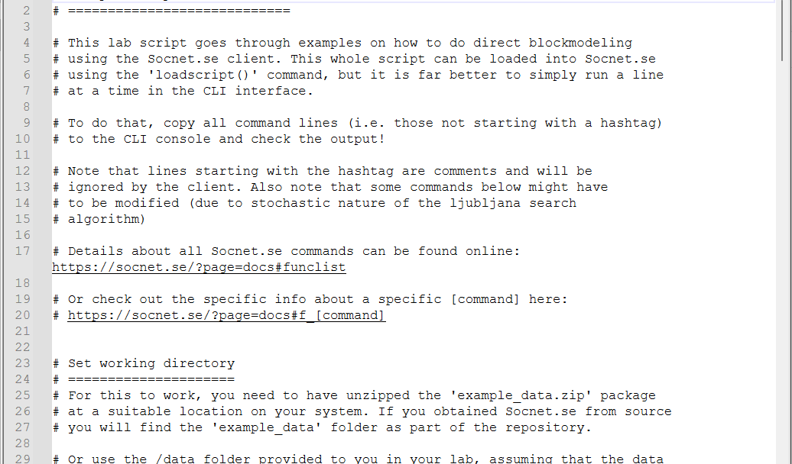
Lab (13-16ish)
Socnet.se
Command-line interface (CLI) console application
Download and install from https://socnet.se/
Script file: socnet_script.txt
Copy and paste (non-commented) commands into Socnet.se client

